Slide 1



Marching to the same drum beat!

Slide 2

Plant SEEEDs, Rethink Growth!

Slide 3

Who are we?
-Sustainable Energy Environmental and Educational Development
-An international consulting organization
-A diverse team of consultants
-Experts in, but not limited to the fields of Energy,
Environment and Education

Slide 4


SEEED also operates in tandem with TSF (The SEEED Foundation), a non for profit organization, [SEEED/TSF] to provide philanthropic and humanitarian services to children and the less privileged.

Slide 5

Where are we?
We are headquarted in Houston, Texas, USA
~with point of contacts (pocs) operating out of;
-Leeds, UK
-Lagos, Nigeria
-Abak, Nigeria
-Detroit, MI, USA
-West Lafayette, IN, USA
-San Antonio, TX, USA

Slide 6
What are we about?
-Proffering solutions to the ever evolving energy, environmental
and educational challenges
-Challenges should be resolved after thorough empirical data collation,
evaluation, analysis and interpretation
Education
Environmental
Energy

Slide 7
Where are we heading?
-Vision of achieving sustainable development in all three areas
-Education is fundamental to SEEED’s vision of enduring sustainable
development
Notes:
Four areas: Economic Development, Engineering , Environment and Education

Slide 8

We solicit to be facilitators of the E. L. Broady Academy – EL-THOMP College of Fundamental Studies
collaboration
SEEED
EL-THOMP
E. L. Broady

Slide 9

“The Light Bulb”
Notes:
This program is aptly tagged “The Light Bulb”

Slide 10
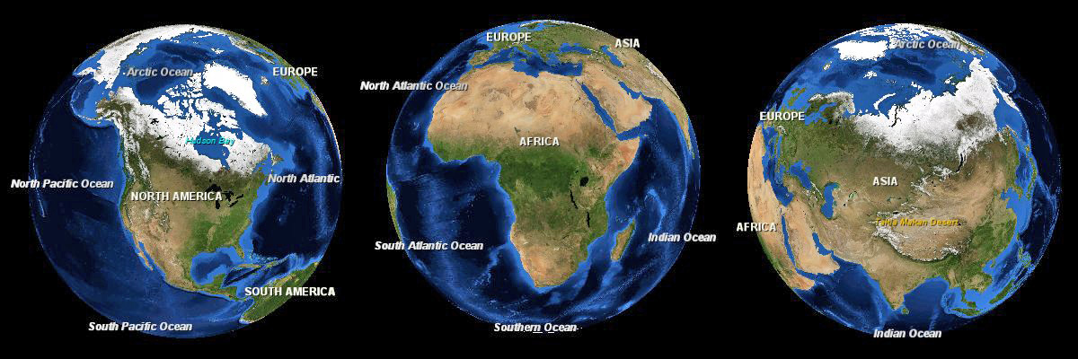
Three images of the Earth showing North America, Africa and Asia to scale
http://en.wikipedia.org/wiki/File:Africa-asia-america-to-scale.jpg
Notes:
Position of Africa relative to the US

Slide 11
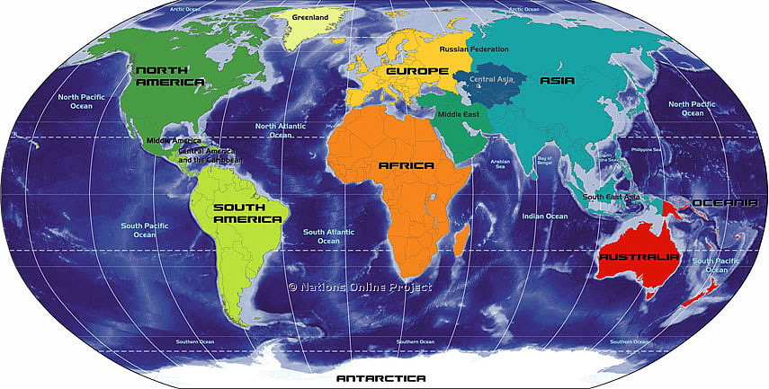
Earth
7 continents
World exceeded 7 billion on 03/12/2012 (United States Census Bureau [USCB])
196 countries
Notes:
Position of Nigeria in Africa

Slide 12
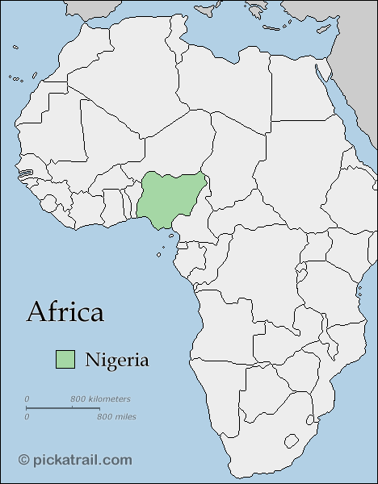
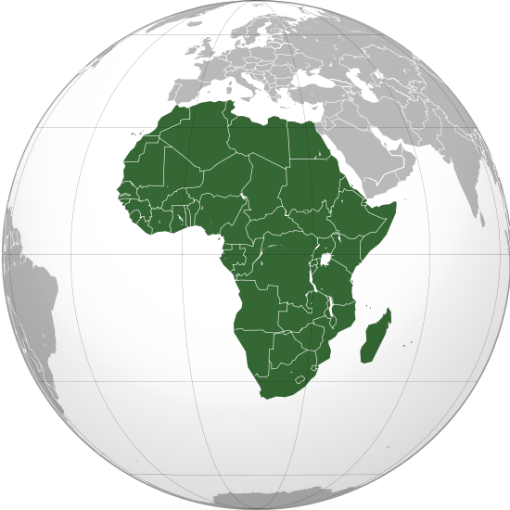
Africa
2nd Largest
2nd most populous
1.032 billion (2011)
56 Countries (number of recognized and defacto)
Notes:
A few fun facts about Africa

Slide 13
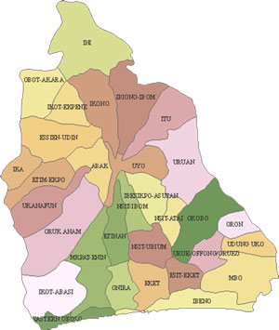
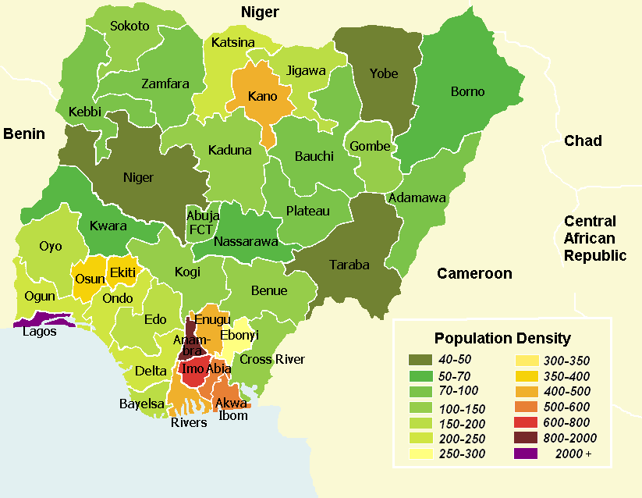


Akwa-Ibom State
Capital: Uyo
4.8 million estimate (2005)
31 LGA
Nigeria
Capital: FCT (Abuja)
Most populous country in Africa
7th most populous country in the world
One out of six black persons is a Nigerian
170.1 million estimate (2012)
36 states
Notes:
A few fun facts about Nigeria. A few fun facts about Akwa-Ibom state. Where Akwa-Ibom state is in Nigeria.

Slide 14
EL-THOMP College of Fundamental Studies
-A novel tertiary institution located in Akwa-Ibom state, Southern Nigeria.
-Akwa-Ibom state is arguably the most economically viable state in Western Africa
Nigerian school system: how it works
Six (6) years of elementary education (Primary 1-6)
Three (3) years of Junior Secondary School education (JSS)
Three (3) years of Senior Secondary School (SSS) education
*(JSS + SSS = a total of six (6) years of secondary school education)

Slide 15
EL-THOMP College of Fundamental Studies
Students are expected to pass the following examinations;
i) Ordinary Level General Certificate of Education (O’Level GCE)
ii) Joint Admissions and Matriculation Board (JAMB)
iii) Individualized University Entrance Examination
Notes:
At the end of secondary school education,
students are expected to pass the
following examinations to be admitted into a tertiary institution i.e. college
Ordinary Level General Certificate of Education (O’Level GCE)
Joint Admissions and Matriculation Board (JAMB)
iii) Individualized University Entrance Examination

Slide 16
EL-THOMP College of Fundamental Studies
-targets students with score deficiencies
-incorporates Christian guidance and counseling programs
-an impressive array of accomplished industry and academic
professionals on its BOD
-has engaged the services of experienced and dedicated faculty
and staff
Notes:
-EL Thomp COF targets students with score deficiencies in
O’ Level GCE, JAMB and Individualized University
Entrance examinations
-E.L. Thomp COF also incorporates Christian guidance and
counseling programs as a critical component of educational
and spiritual success
-EL-Thomp COF has an impressive array of accomplished
industry and academic professionals on its board of directors
committed to the success of its program
-EL-Thomp has engaged the services of experienced and
dedicated faculty and staff committed to the actualization of its
program goals

Slide 17
EL-Thomp College of Fundamental Studies
Plot 22-24 Ikot Nsidem Road (off Ikot-Ekpene Road), Utu Abak,
P. O. Box 518, Abak,
Akwa-Ibom state
Nigeria
Programs Available:
A. School of Arts
i. English Language
ii. Literature in English
iii. Christian Religious Knowledge
iv. History
B. School of Social Sciences
i. Accounting
ii. Economics
iii. Geography
iv. Government
v. Business Management
vi. Commerce
C. School of Sciences
i. Mathematics
ii. Physics
iii. Chemistry
iv. Biology
v. Agricultural Science
vi. Computer Science
D. School of Agricultural Production
i. Crop Production
ii. Animal Production
iii. Fisheries and Aquaculture
iv. Horticulture

Slide 18
EL-Thomp College of Fundamental Studies
Remedial Program
This is a one year full-time (2 Semesters) O-Level programme for candidates who could not make the required O-Level credits at the Senior School Certificate Examinations (WASSC/NECO, GCE)
Admission Requirements
Prospective candidates must have at least two (2) credits and two (2) passes at the O/L WASSC, NECO, GCE or NABTEB
Advanced Level Cambridge/Advanced Level G.C.E Program
Candidates in this category are expected to complete a one year full-time (2 semesters) programme
Admission Requirements
Prospective candidates must have at least five O/L credit passes, at two sittings or less in WASSC, NECO, G.C.E or NABTEB
Certificate Programs
This is a full-time or part-time One Year (2 semesters) Programme leading to an award of Certificate of Proficiency in relevant area.
Admission Requirements
Prospective candidates must have at least three (3) credit passes at O/L WASSC, G.C.E., NECO, etc.

Slide 19
EL-THOMP College of Fundamental Studies
The Founder:
Israel Thompson Eshiet, Ph.D. (Organic Chemistry) Professor Emeritus, Science Education
Deputy Vice-Chancellor (Administration, former)
University of Uyo, Nigeria
Notes:
*Need to insert picture of Founder and School building.

Slide 20
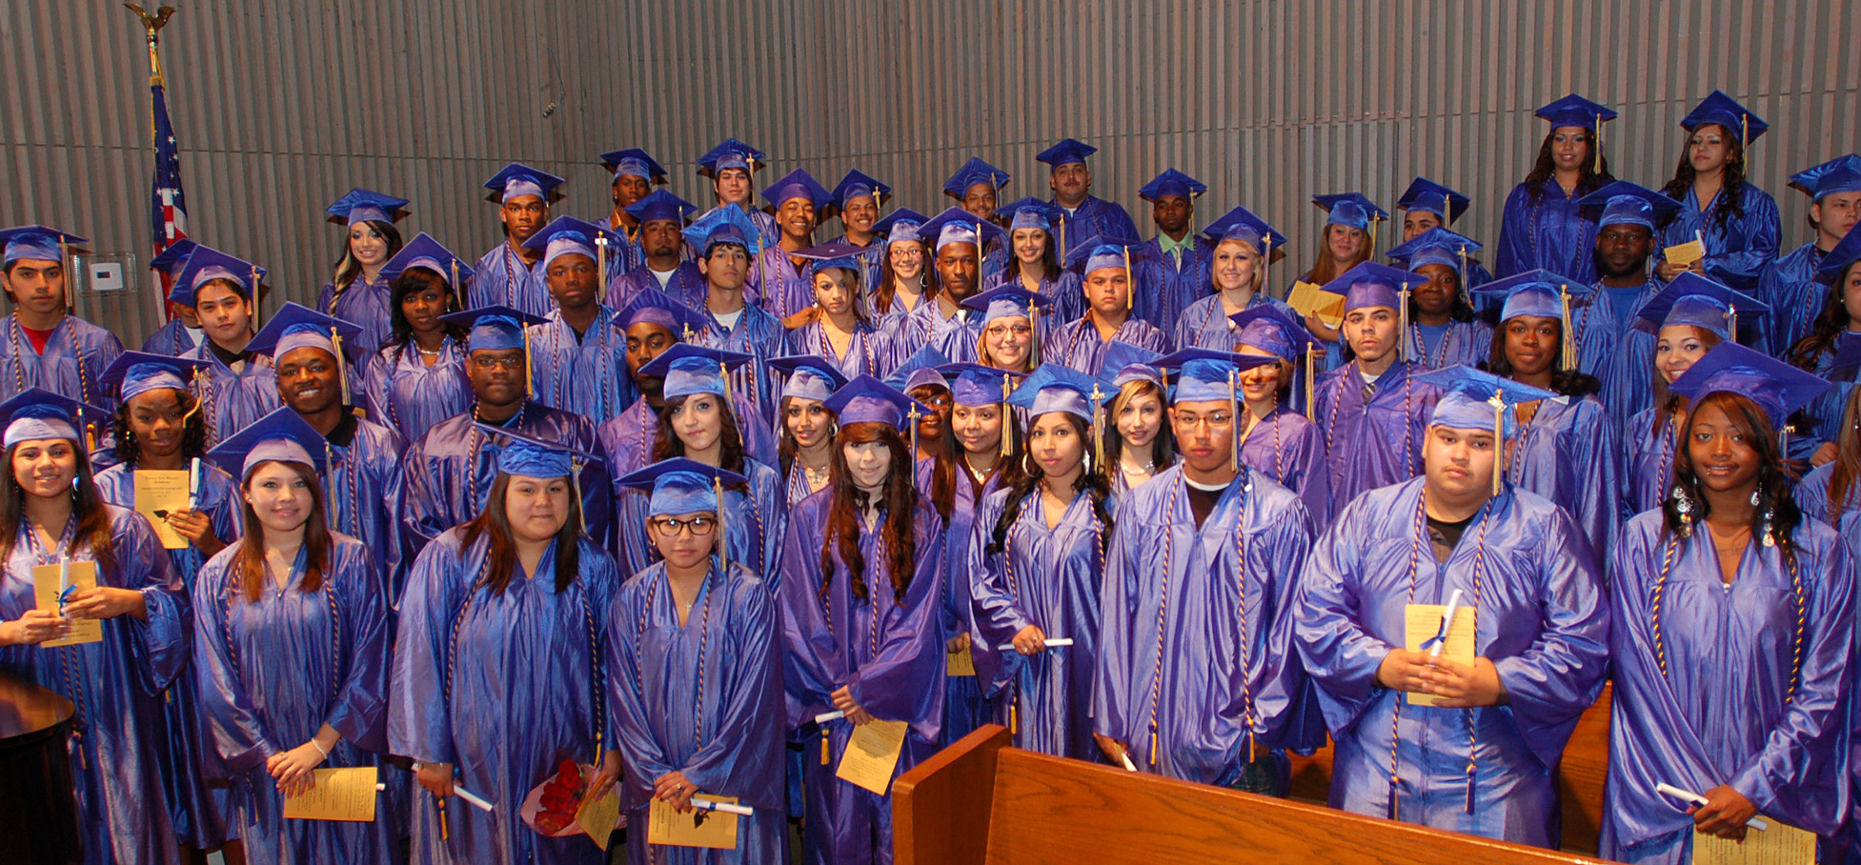
EL-Broady Academy
-a highly reputable academic institution that enjoys tremendous success in changing
and shaping the destiny of students
-provides diploma completion for adults in a home setting
-services include credit recovery and summer school amongst others
Notes:
E. L. Broady Academy is a highly reputable academic institution that enjoys
tremendous success in changing and shaping the destiny of students
-E. L. Broady Academy provides diploma completion for adults in a home setting
-E. L. Broady Academy services include credit recovery and summer school amongst
others

Slide 21
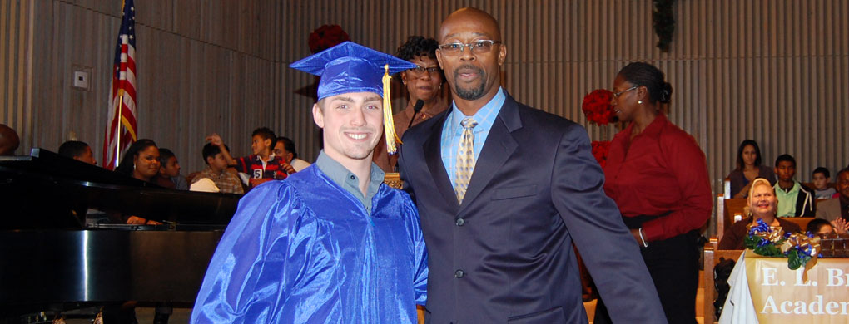
EL-Broady Academy
The Founder:
Pastor Ricky Hooker. M.Sc.
Superintendent of San Antonio Charter School District (former)
City of San Antonio’s largest Charter School
Pastor, The Fountain Christian Church, San Antonio

Slide 22
In Partnership
E. L. Broady Academy targets the same category of students (in USA) and shares the same vision as EL-Thomp COF Studies
Education
Christian guidance and counseling
Academic Instruction

Slide 23
In Partnership
E. L. Broady Academy
This presents an opportunity for E. L. Broady Academy to;
-participate in the growth and success of EL-Thomp College of Fundamental Studies
-incorporate a real-time, hands-on, interactive, international perspective into her program
-explore Africa’s rich cultural heritage
Notes:
This presents;
-An opportunity for E. L. Broady Academy to participate in the growth and success of
EL-Thomp College of Fundamental Studies
-An opportunity for E. L. Broady Academy to incorporate a real-time, hands-on, interactive
international perspective into her program
-An opportunity for E. L. Broady Academy to explore Africa’s rich cultural heritage

Slide 24
In Partnership
EL-THOMP College of Fundamental Studies
This presents an opportunity for EL-THOMP to;
-have access to cutting edge educational resources
-receive mentoring/guidance
Notes:
This presents;
-An opportunity for EL-THOMP to have access to cutting edge educational resources i.e. books,
computers etc.
-An opportunity for EL-THOMP to receive mentoring/guidance from a highly reputable and
successful international program
-This presents an excellent opportunity for both institutions to have a mutually beneficial
relationship

Slide 25
In Partnership
E. L. Broady Academy
EL-THOMP College of Fundamental Studies
This presents an excellent opportunity for both institutions to have a mutually beneficial relationship
Notes:
This presents;
-An opportunity for EL-THOMP to have access to cutting edge educational resources i.e. books,
computers etc.
-An opportunity for EL-THOMP to receive mentoring/guidance from a highly reputable and
successful international program
-This presents an excellent opportunity for both institutions to have a mutually beneficial
relationship

Slide 26
Our Proposal
SEEED
Interaction of faculty and staff of both institutions;
- Online interaction at the first instance
- Summer travel program
2. Interaction of students:
- Online interaction at the first instance
- Summer travel program
Notes:
Interaction of faculty and staff of both institutions:
- Online interaction at the first instance i.e. online seminar presentation and tutoring
- Summer travel program for faculty and staff in succeeding years
2. Interaction of students:
- Online interaction at the first instance i.e. performing common assignments and exercises
- Summer travel program for students in succeeding years

Slide 27
SEEED Campaign:
1. Create public awareness;
-Publish articles in newspapers etc.
-Publish articles in peer reviewed academic journals
-Publish postings in blog – ‘The SEEED Blog’: http://theseeedblog.wordpress.com
2. Solicit for funds to support this program;
-From government
-From non-governmental (private) sector
Notes:
1. Create public awareness;
-Publish articles in newspapers etc. in USA, UK, Nigeria and among Nigerians in the diaspora
~i.e. Houston Chronicle, International Guardian, The Pioneer etc.
-Publish articles in peer reviewed academic journals
-Create a blog
2. Solicit for funds to support this program;
-From government
-From non-governmental (private) sectors in USA, UK and Nigeria

Slide 28
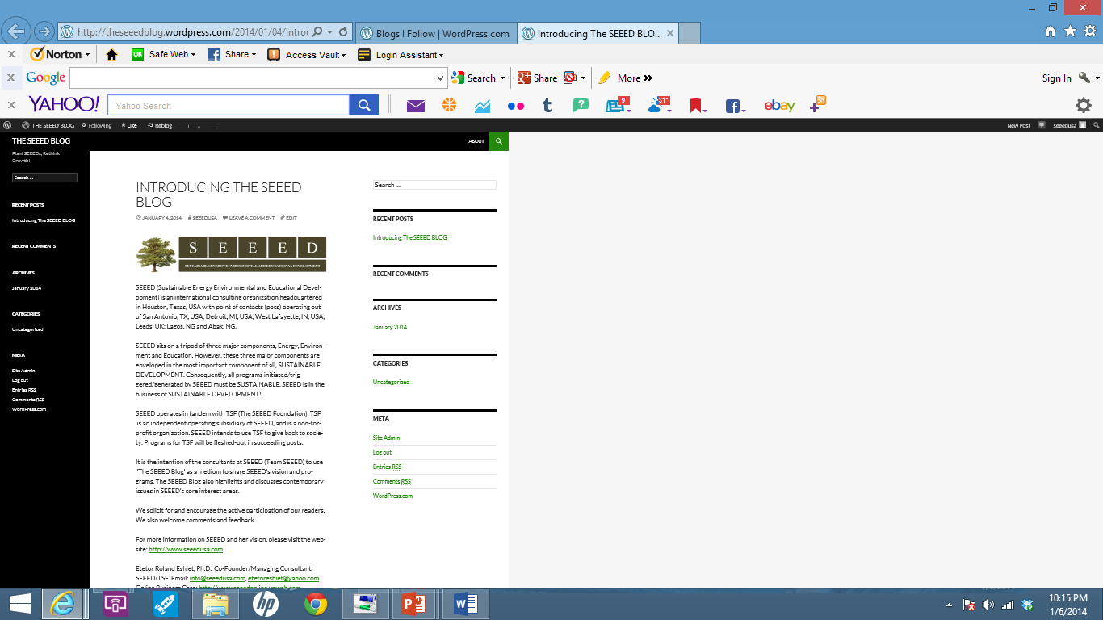
The SEEED Blog

Slide 29
Seeds & Soils
Why are we doing this?
-The parable of the sower (Mathew 13: 1-9)
“But the seeds that fell on the good soil yielded a crop: some a hundredfold, some sixty, some thirty.” (v.8)
SEEED considers our students good soil!

Slide 30



The value of an Education with an international perspective:
“According to Forrester Research, over the next fifteen years over three million US service industry jobs and up to $136 billion in wages will move overseas to countries including India, Russia, China and the Philippines. Forrester also notes that 88% of the firms said they got better value for their money overseas and 71% said overseas workers did better quality work.”⁹
An education with an international perspective puts our students in good stead!

Slide 31
This collaboration will make students from both sides of the pond
decidedly [globally] marketable and ready to compete with the increasing demands of today’s and tomorrow’s labor market.

Slide 32
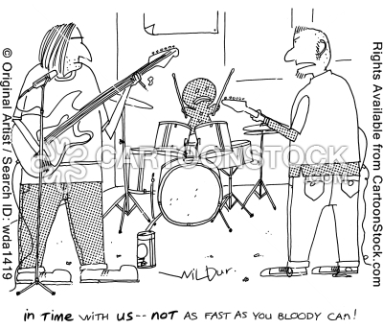
Marching to the same drum beat!

Slide 33
References
SEEED website: http://www.seeedusa.com
2. Notes on EL-Thomp College of Fundamental Studies (I. T. Eshiet 2013).
3. Three images of the Earth showing North America, Africa and Asia to scale: http://en.wikipedia.org/wiki/File:Africa-asia-america-to-scale.jpg
4. Map of World: http://www.nationsonline.org/oneworld/small_continents_map.htm
5. Map of Africa showing Nigeria:
http://www.google.com/imgres?imgurl=http://maps.pickatrail.com/africa/map/nigeria.gif&imgrefurl=http://maps.pickatrail.com/africa/nigeria.html
6. Map of Nigeria showing population density:
http://www.google.com/imgres?imgurl=http://upload.wikimedia.org/wikipedia/commons/0/0a/Population_density_map_of_Nigerian_states_-_English.png&imgrefurl
7. Map of Akwa-Ibom State Nigeria:
http://www.google.com/imgres?imgurl=http://www.akwaibomnewsonline.com/images/akwa-ibomstate.jpg&imgrefurl
8. El-Broady Academy website: http://www.broadyacademy.com
9. Doyle, A. Where have all the jobs gone? About.com Guide. http://www.jobsearch.about.com/cs/careerresources/a/offshore.htm Viewed on 10/16/2013.
10. Cartoon:
https://www.google.com/search?q=cartoon+questions&tbm=isch&tbo=u&source=univ&sa=X&ei=5StfUv6bLqjB2wXBy4H4Ag&ved=0CDUQsAQ&biw=1518&bih=646
http://cartoonstock.com
http://www.dreamstime.com/royalty-free-stock-photos-cartoon-light-bulb-image17648518
11. Stowell, J. The End?, Our Daily Bread. http://odb.org/2013/10/18/the-end/. Viewed on 10/18/2013.

Slide 34

QUESTIONS?

Slide 35
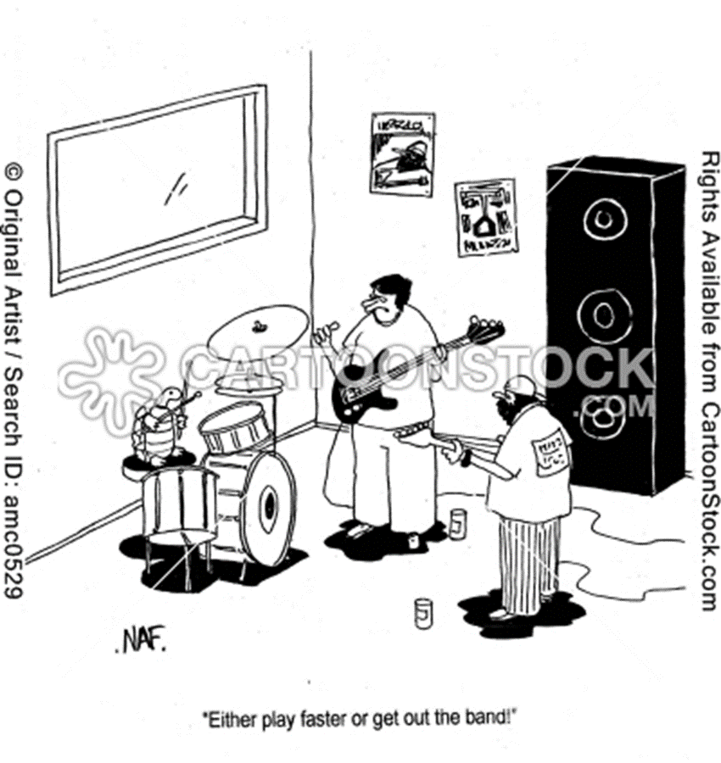

Slide 36
In Christ, the end is only the beginning!¹¹

Slide 37
TEAM SEEED
Derec Moore, B.A. (Texas Tech University), M.A (St. Mary’s University)
Spokesperson/Coordinator, Education Development; poc@San Antonio
Etetor Roland Eshiet, Ph.D. (Texas Tech University)
Co-Founder/Managing Partner
Kenneth Imo-Imo Eshiet, Ph.D. (University of Leeds)
Co-Founder; poc@UK
Ata Ubokudom, Ph.D.
Chief Executive Consultant; poc@Detroit
Maureen Saduwa, M.A. (Brandeis University)
Director, Programs
Emmanuel Ben-Edet, M.A. (University of Lagos, NG), M.A. (University of Uyo, NG), M.SW. in view (University of Houston); poc@Houston
Nsikak Udo-Imeh, M.Sc. (Ahmadu Bello University), M.Sc. (EmbryRiddle Aeronautical University), Ph.D. in view (Purdue University; poc@West Lafayette
Asian Dora Essien, LLB, BL. (University of Uyo, NG), LLM (University of Lagos, NG); poc@Lagos
I. T. Eshiet, B.Sc. 1st Class (University of London), Ph.D. (University of Ibadan, NG); poc@Abak

Slide 38
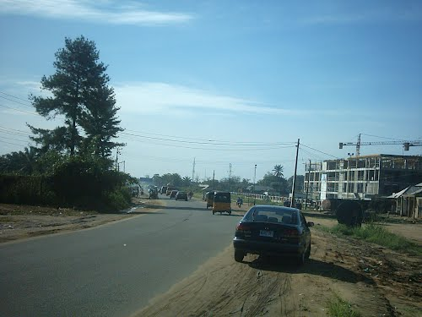
Abak, Akwa-Ibom State, Nigeria

Slide 39

Abak, Akwa-Ibom State, Nigeria

Slide 40
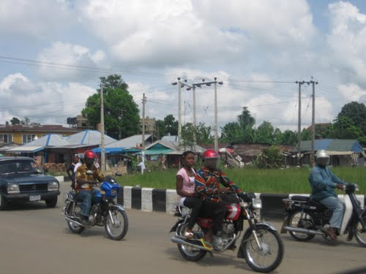
Abak, Akwa-Ibom State, Nigeria

Slide 41
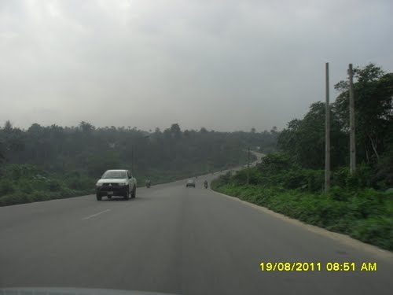
Abak, Akwa-Ibom State, Nigeria

Slide 42
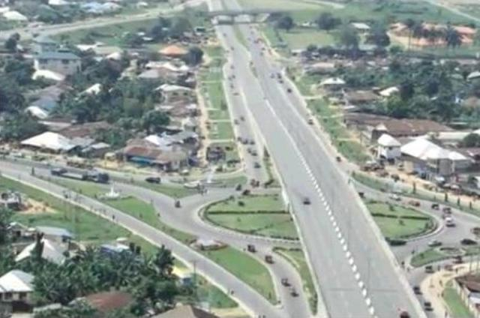
Uyo, Akwa-Ibom State, Nigeria

Slide 43
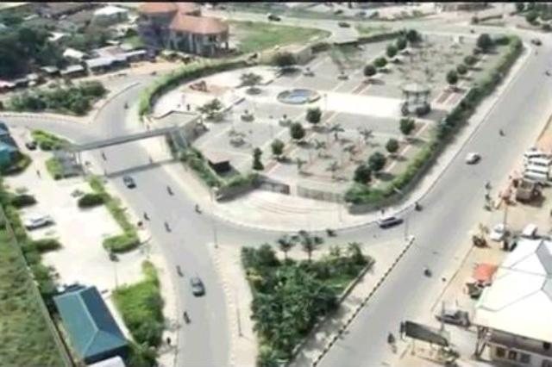
Uyo, Akwa-Ibom State, Nigeria

Slide 44
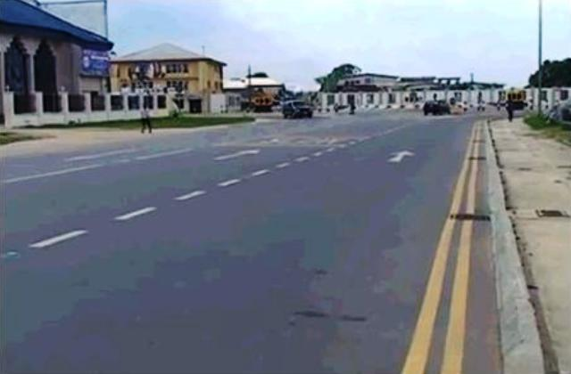
Uyo, Akwa-Ibom State, Nigeria

Slide 45
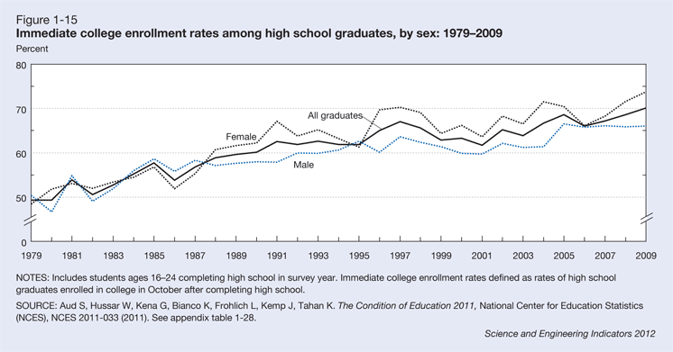
http://www.nsf.gov/statistics/seind12/c1/c1s4.htm

Slide 46
Questionnaire
What to the nearest percentage is the transition rate of high school students to tertiary institutions
(universities and colleges) in the United States today?
a) 50% b) 40% c) 70% d) 80% e) 30%
2. What is the gross enrollment of college-aged persons in tertiary institutions (universities and colleges)
in Nigeria?
a) 50% b) 9.2% c) 25% d) 4.3% e) 30%
3. What percentage of the world’s population are African’s comprised of?
a) 10% b) 15% c) 20% d) 30% e) 5%
4. What is the most populous country in Africa?
a) South Africa b) Egypt c) Kenya d) Nigeria e) Libya
5) How may countries to the nearest tenth are there in the world?
a) 100 b) 200 c) 150 d) 300 e) 250

Slide 47
Questionnaire contd.
6. Which African personality has made the most impact in the world’s polity?
a) Nelson Mandela b) Idi Amin Dada c) Kwame Nkrumah d) Desmond Tutu e) Muammar al-Gaddafi
7. Where is Mount Everest?
a) Nepal-China border b) Togo – Republic of Benin border c) Nigeria-Cameroun border
d) US-Canada border e) US – Mexico border
8. The US Census Bureau suggests that the increase in the earning potential of baccalaureate degree holders over
high school graduates (40 year period [25-65 years]) has risen progressively over time and its presently?
a) 50% b) 40% c) 85% d) 75% e) 62%

Slide 48
Useful Links
Nigeria Gross Enrollment Data:
http://www.nationmaster.com/graph/edu_ter_enr-education-tertiary-enrollment
2. United States Embassy: Nigeria Education Sheet:
http://photos.state.gov/libraries/nigeria/487468/pdfs/JanuaryEducationFactSheet.pdf

